Slide 1
12-1 Getting Paid
5CM503 Virtual Environment Development
Dr Patrick Merritt

Slide 2
Contents
How do we get paid?

Slide 3
Why do we make games?
Many of us have personal reasons for why we choose to make games.

Slide 4
Maslow’s Hierarchy of Needs
“Maslow's hierarchy of needs is a motivational theory in psychology comprising a five-tier model of human needs, often depicted as hierarchical levels within a pyramid.” (Saul McLeod, 2007)
Essentially this model shows the needs that human beings have in a hierarchical structure ranging from the essential survival-based elements at the bottom to the structure to the desires needed to require a fulfilling life.
Read this → https://www.simplypsychology.org/maslow.html

Slide 5
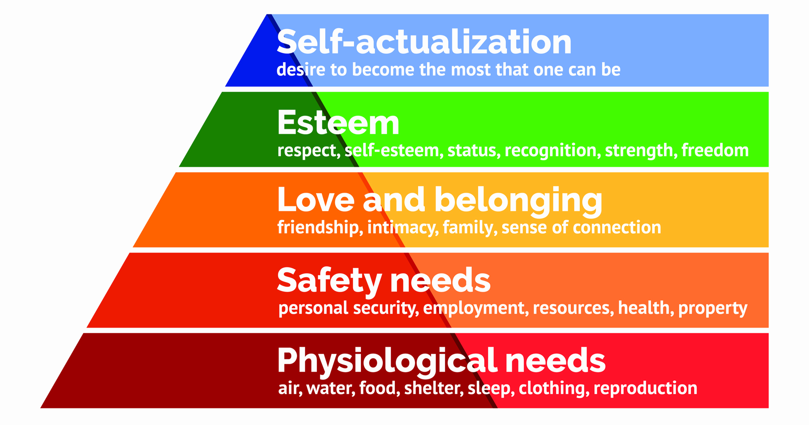

Slide 6
D-Needs
Motivate people when they are unmet.

Slide 7
B-Needs
Motivate people when D needs are met to allow personal growth.
D-Needs
Motivate people when they are unmet.

Slide 8
Satisfying needs
It is important to acknowledge that an individual does not require an all or none approach to each layer.
For example, an individual’s safety needs can be met without employment or employment which is undesired.
Each individual determines what is sufficient for themselves.

Slide 9
Why does this matter?
How do you fulfil any of these needs?

Slide 10
Money!
Like it or not, modern society revolves around money.
You use it to satisfy all of your needs in some way.
While living off the grid is possible. Most trade uses a currency of some form as an intermediary.
Therefore, you work for a salary to exchange for goods and services to meet your needs.

Slide 11
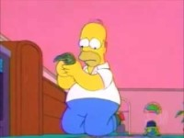

Slide 12
Creative vs Corporate
For the most part, as the creatives. We really don’t care about making money.
We are employees driven by passion. Not necessarily money
Although money is nice ☺
Buying tools is nice.
Having a home is nice.
Having a family is nice.
Eating is somewhat important.

Slide 13
Why do we perform marketing?
Without it, nobody knows about your product beyond word of mouth.
Convince potential customers to purchase your product.
Because our competitors are doing it!

Slide 14
Traditional marketing
The door-to-door salesman.
Mostly redundant, has evolved into a specific form of marketing on the internet…
Still valid for some businesses, such as double glazing.
Word of mouth
Free, but relies on product quality to get a positive message across.

Slide 15
Print Marketing
Leaflets
Delivered via mail.
Handed out in public places.
May have incentives such as discount codes.
Traditional adverts
TV, Film, Magazines etc.

Slide 16
Internet marketing
Online Advertisements
Pay a website to run adverts that drive traffic to your page selling your product.
Sponsored articles.
Email campaigns.
Injecting adverts into free content (Youtube)

Slide 17
Search Engine Optimization
The vast majority of people use a search engine on the Internet to find things they want.
You can pay these search engines to display links to your website when certain terms are searched.
AND / OR
You can optimise your website content to be more attractive to search engine algorithms making your website more likely to appear higher up in the results.

Slide 18
Blog Marketing (Influencers)
Pay individuals with a large following on social media following to use your product prominently in their posts.
Can have MAJOR backlash if the individual does something inappropriate.
If the individual does not disclose the promotion to the audience, MAJOR backlash can occur.
https://www.ftc.gov/news-events/news/press-releases/2017/09/csgo-lotto-owners-settle-ftcs-first-ever-complaint-against-individual-social-media-influencers

Slide 19
Social Media Marketing
Brand runs multiple social media pages to communicate with customers.
Often tries to give the brand a persona.
https://www.boredpanda.com/funny-wendy-jokes/?utm_source=google&utm_medium=organic&utm_campaign=organic

Slide 20
The 7 P’s and 4 C’s of Marketing
Product
Price
Place
Promotion
People
Process
Physical Evidence
Consumer wants and needs
Costs
Convenience
Communication

Slide 21
Product
The thing you are selling!
You must know what the product is to be able to advertise it properly.
What is the USP, and why is it better than the competing products?

Slide 22
Price
The price often is dictated by your position in the market.
Are you cheap and cheerful and lower priced than your competitors?
Are you the high-quality product that is more expensive but vastly superior to your competitors?
Do you have brand leverage you can lean on to justify an increased price?

Slide 23
Place
Ideally, you present your advertisement in the right place at the right time.
Preferably where the opportunity to create a sale is most ideal.
Largely dictated by the product and the target audience.

Slide 24
Promotion
Making people aware of what you are selling and why.
Play up the desirable features.
Downplay the impact of any undesirable elements.

Slide 25
People
How does the company interact with its customers?
Do you provide good customer service? Poor customer service generates negative word of mouth.
Do you do good things for the environment/community?

Slide 26
Process
How do you deliver your products to the end customer?
Is the product easy to obtain and operate?
Do you support customers with problems?

Slide 27
Physical evidence
Only applies to physical retail locations
Is the sales environment appropriate for the product?
Does it actively entice customers to make purchases?

Slide 28
Consumer Wants and Needs
Does your product fill a need for the consumer?
What type of need is it?
Is it a D or B need?

Slide 29
Cost
Not just the price of the product but all the factors influencing the cost of obtaining the product.
Shipping?
Travel?
Taxes and insurance?

Slide 30
Convenience
How available are your product and its competitors?
Supply and demand, if you control the only supply in a high demand area you can charge a premium for it and advertise it as such.

Slide 31
Communication
Tell us what you think!
Opening a dialogue between the customer and business to give feedback and or address complaints.

